Slide 1
Mahamud Hasan
ID: 1420453042
Serial: 71
Project: Kitchen Environment monitoring system

Slide 2
GOAL
MY GOAL IS TO THE MAINTAIN STANDARD KITCHEN ENVIRONMENT
AND IT WILL BE CHECKED BY THE SYSTEM.
THE OUTCOME OF THE PROJECT IS SAFE AND HEALTHY KITCHEN ENVIRONMENT.

Slide 3
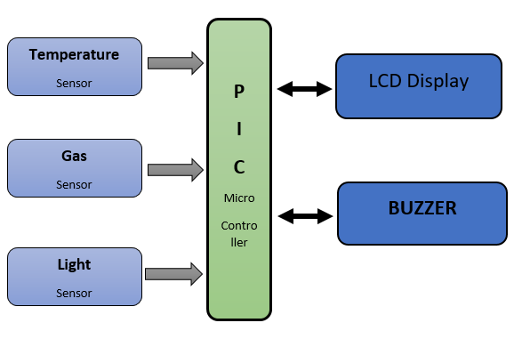
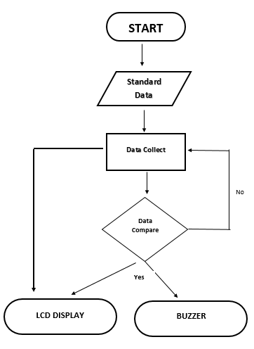
BLOCK Diagram
FLOW Chart

Slide 4
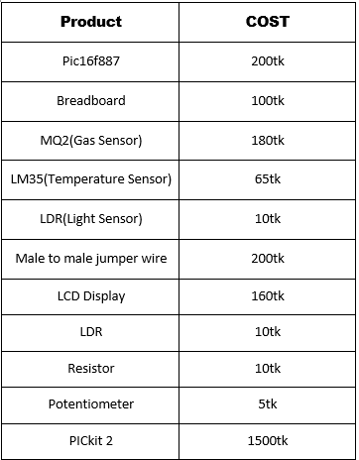
All Product Cost Details

Slide 5
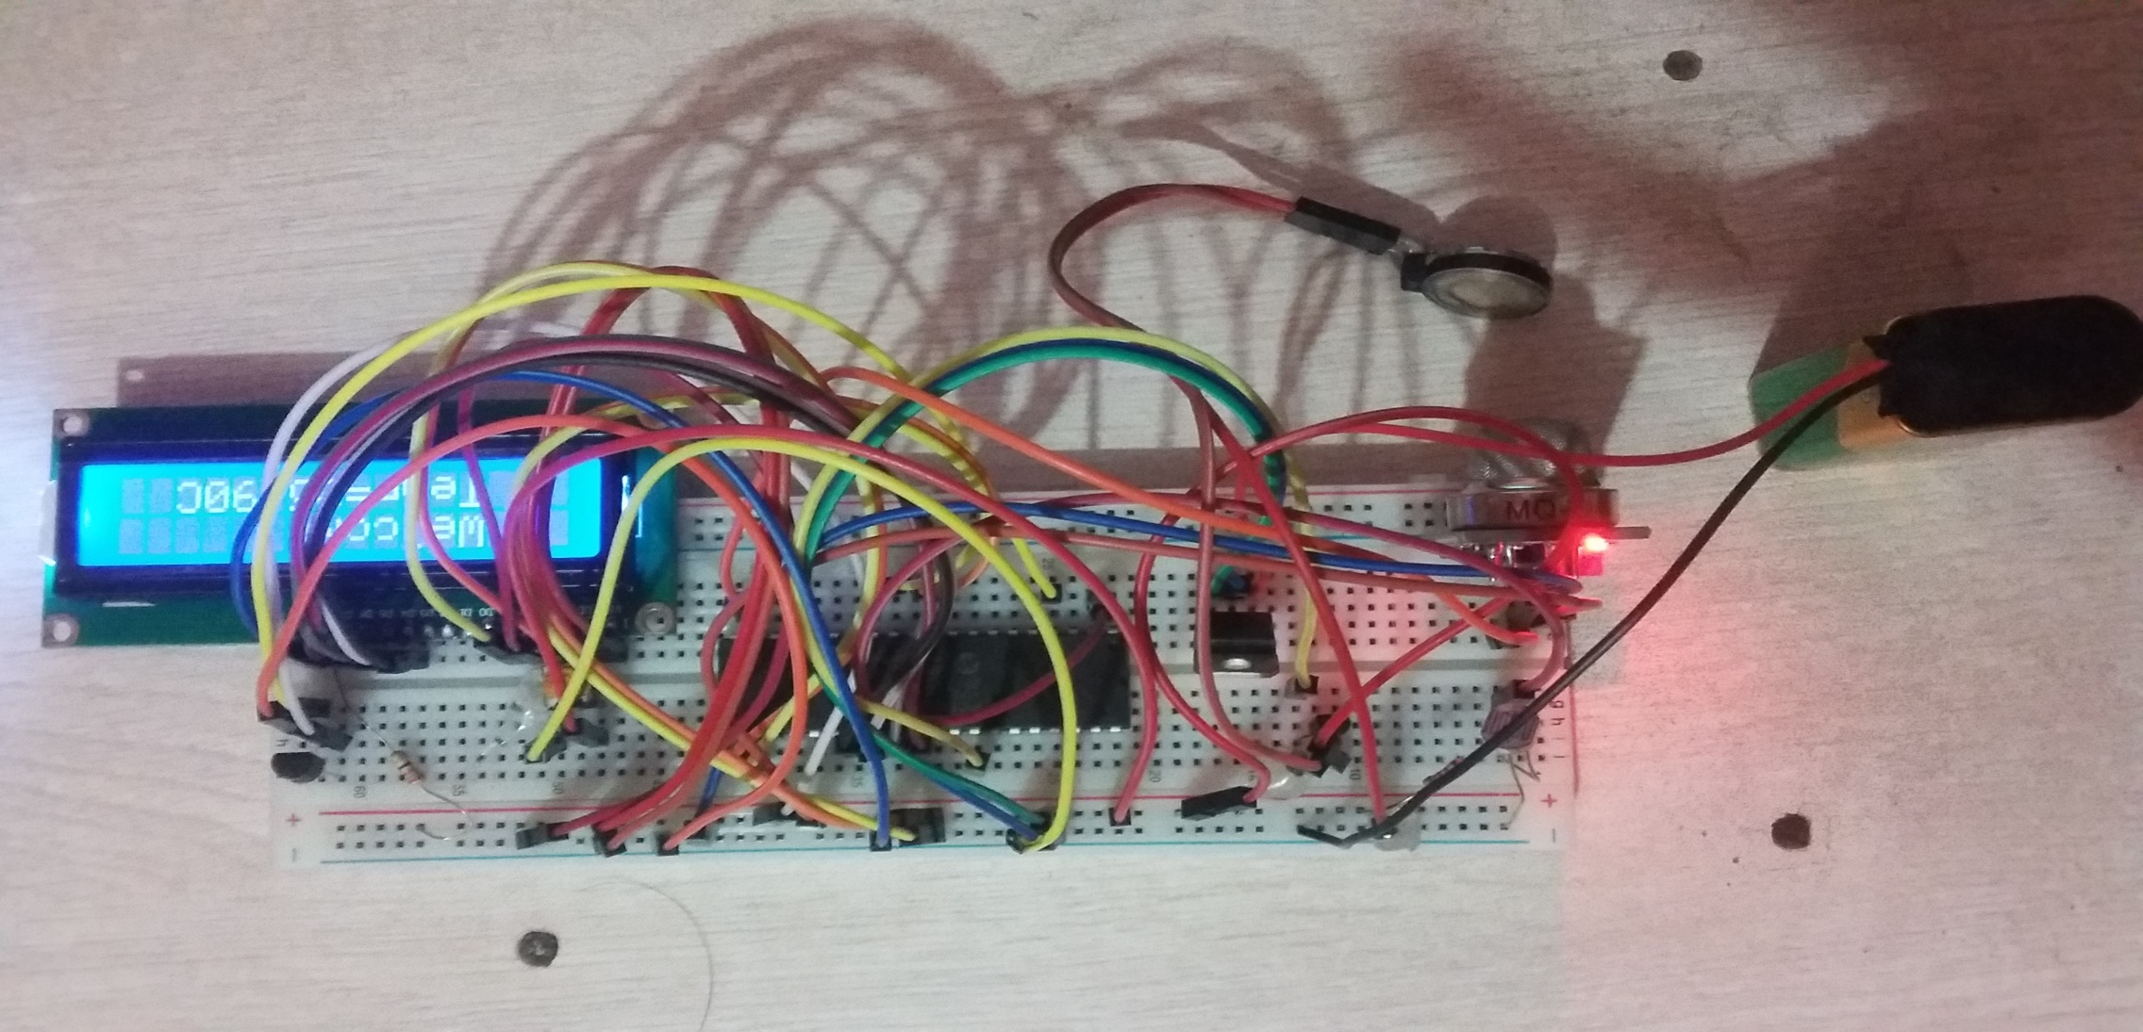
Final System Picture

